Slide 1
Event Ticket Booking Database
A reliable MySQL system for discovering events, reserving tickets, processing payments, and tracking bookings.

Slide 2


PROJECT LOGIC
The project turns ticket booking into one controlled flow
Connected tables
Customers, events, bookings, and payments live in connected tables.
Visible status
The design keeps availability, payment status, and booking status visible in one system.
Controlled outcome
Goal: prevent invalid bookings while giving staff useful reporting data.
One system from discovery to reporting.

Slide 3
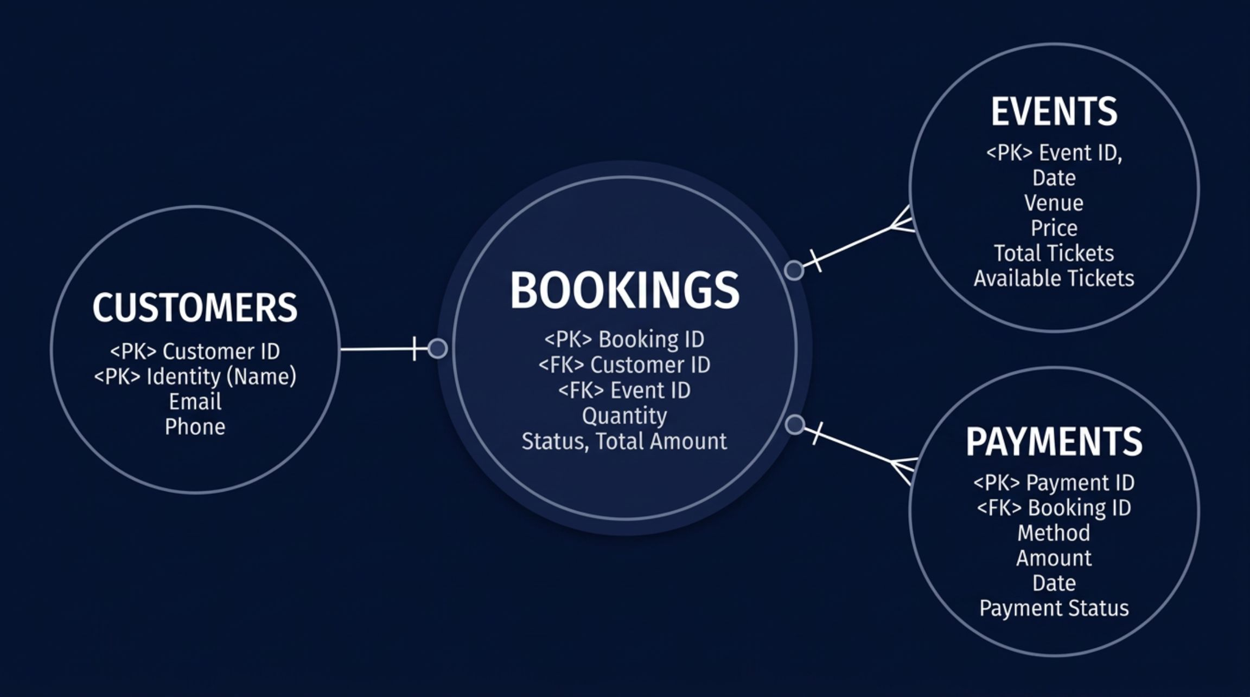
DATA MODEL
Four core tables model the booking journey
The booking is the bridge between customer, event, and payment.

Slide 4




INTEGRITY RULES
Relationships keep the data consistent
Constraints act as guardrails around the booking model.
Ownership
Traceability
Safe values
Each booking belongs to one customer and one event through foreign keys.
Each payment is tied to a booking, creating a traceable money trail.
Checks protect positive ticket quantities, non-negative amounts, and valid availability ranges.

Slide 5
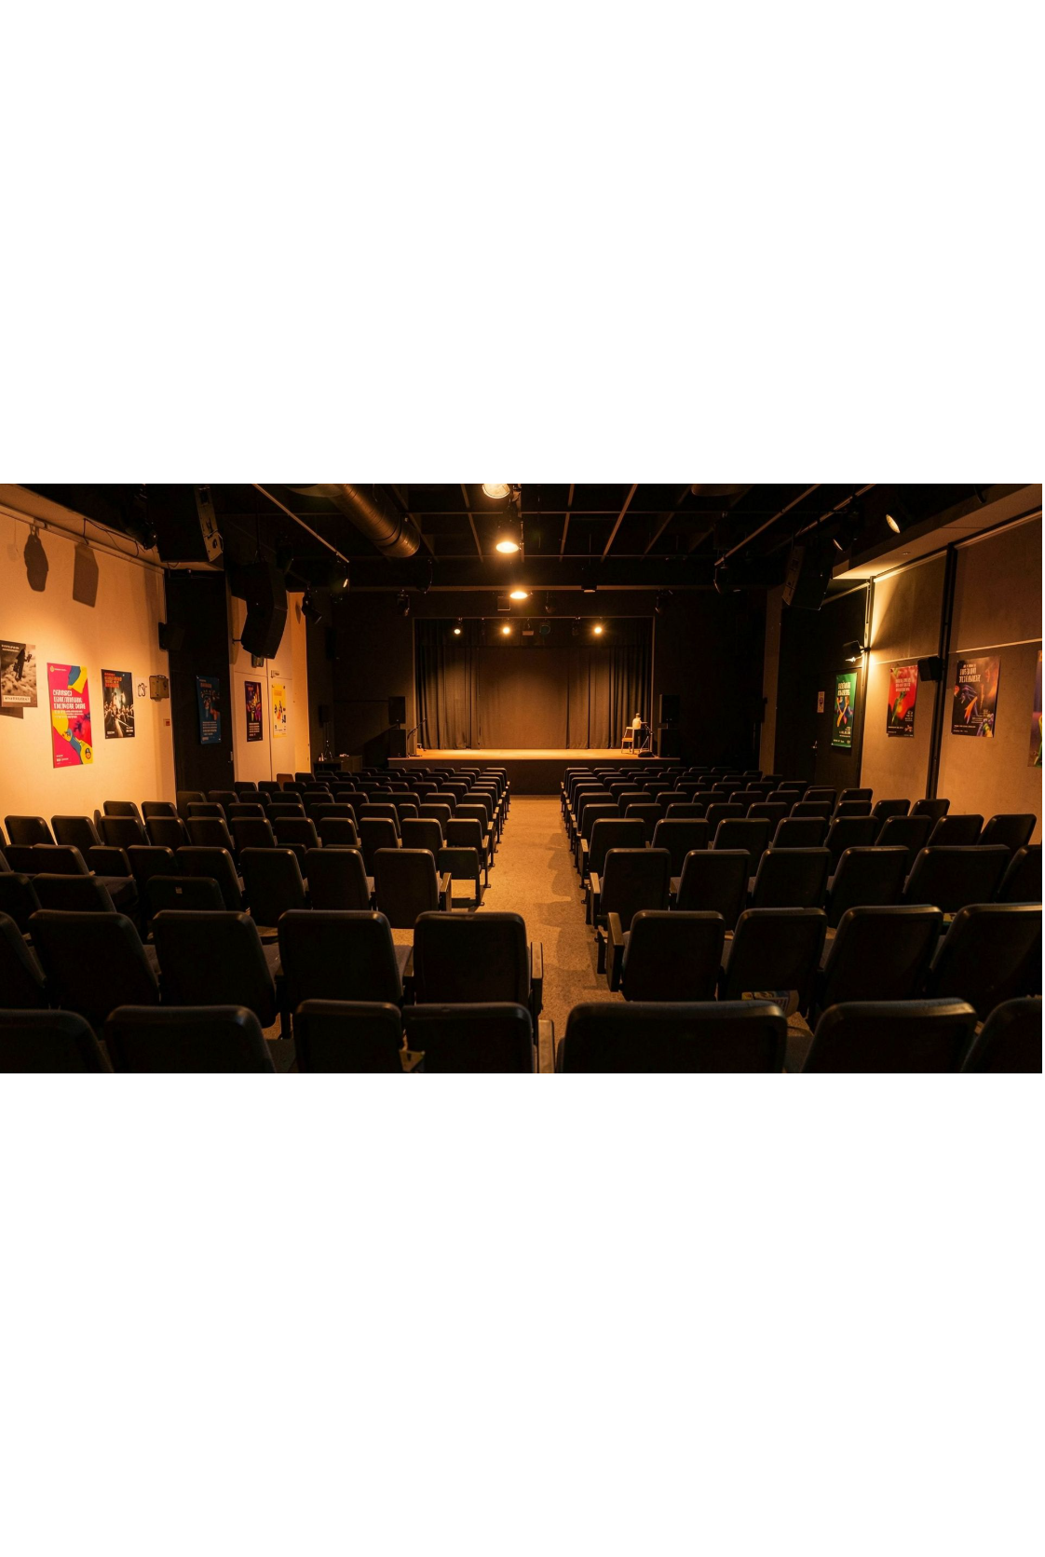
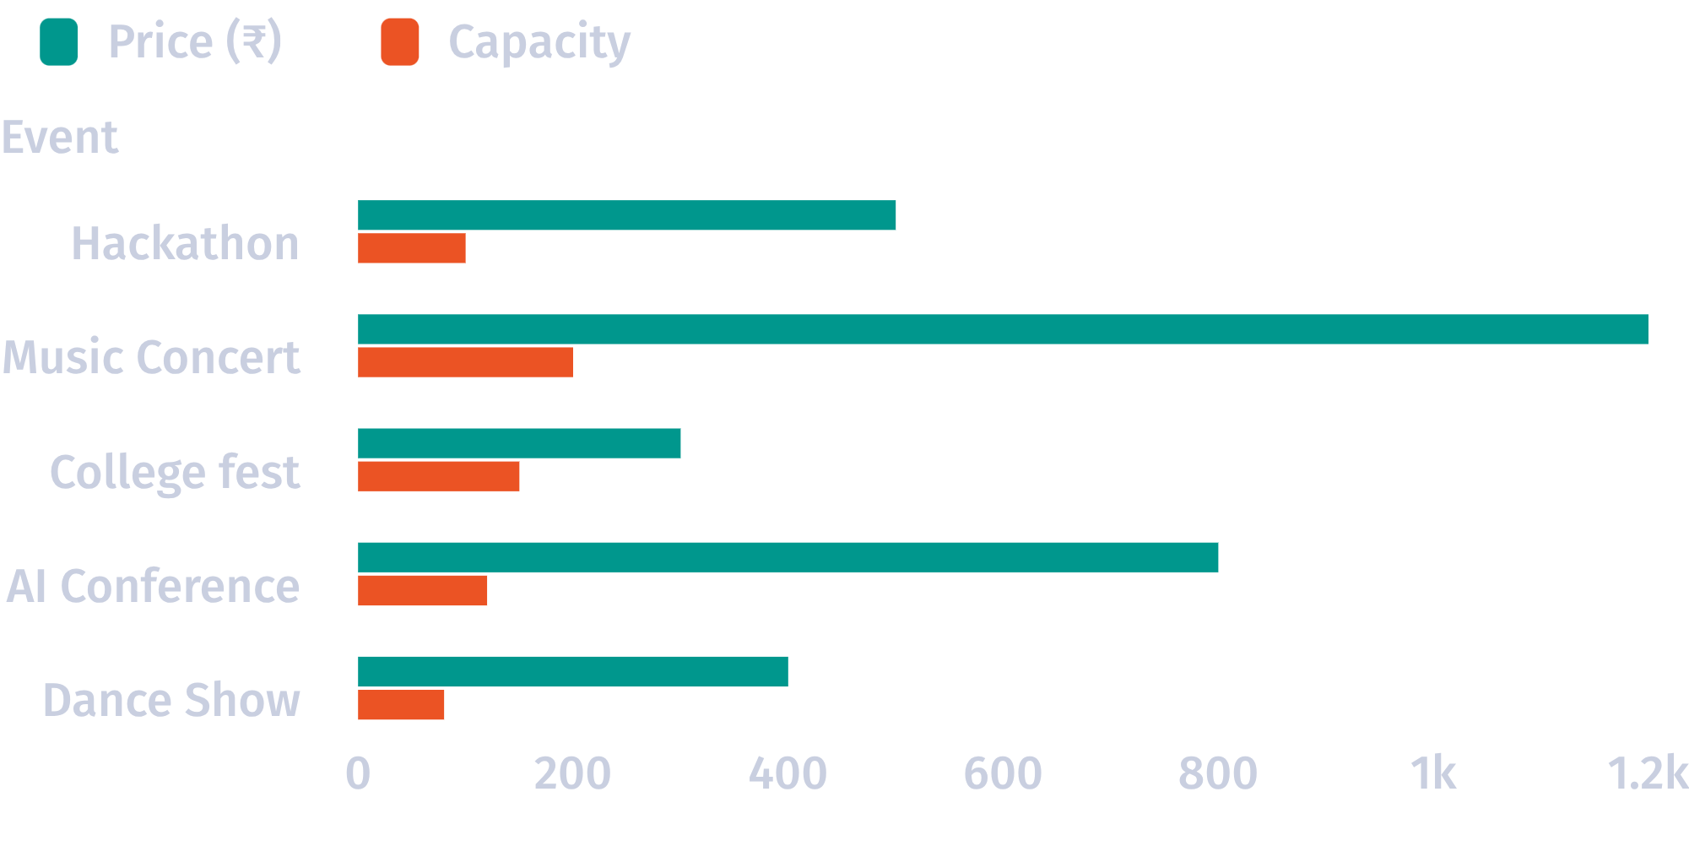
SAMPLE INVENTORY
Sample data proves the system supports varied events
Five seeded events span different types, prices, and capacities.

Slide 6
STORED PROCEDURE
The booking procedure protects every reservation
01
02
03
04
05
Validate
Lock
DECISION GATE
Confirm
Commit
Validate customer and ticket quantity.
Lock the selected event row and read current availability.
Reject
Calculate the total and insert a confirmed booking.
Reduce available tickets and commit the transaction.
Reject the request when the event is missing or sold out.
The decision gate is explicit: missing or sold-out events do not reach confirmation.

Slide 7
TRANSACTION SAFETY
Transactions prevent partial bookings
SUCCESSFUL PATH
ERROR PATH
Commit
Rollback
The booking flow starts a transaction before changing inventory.
Row locking helps protect availability during concurrent booking attempts.
Booking plus inventory update completes together.
Exceptions trigger rollback.
Failed requests do not leave half-completed updates.
The reservation and inventory change are undone together.
A reservation is either complete or it leaves no partial state behind.

Slide 8


AUTOMATIC SAFETY
Triggers add automatic safety checks
BEFORE INSERT
AFTER CANCELLATION
BEFORE PAYMENT INSERT
Confirmed booking
Availability restored
Payment amount
Block confirmed bookings that exceed available tickets.
Restore the cancelled ticket quantity to event availability.
Reject negative payment amounts.

Slide 9



REPORTING LAYER
Views, joins, and indexes turn data into decisions
Customer bookings
Confirmed bookings
Event totals
Date search
The booking_details view combines customer, event, booking quantity, status, and amount.
Joins answer who booked which event and for how much.
GROUP BY and HAVING surface event booking counts.
An index supports date-based searches.
The database becomes a reporting tool, not only a place to store bookings.

Slide 10
PROJECT REVIEW
What the project demonstrates
Normalized model | A normalized model connects the full ticket lifecycle from customer to payment
Safer operation | Procedures, constraints, transactions, and triggers make the system safer to operate
Useful analysis | Views and analytical queries make the database useful beyond data entry
Next step | Next step: add authentication, a user interface, refunds, and real-time notifications

